Slide 1

Ing. Dr. P. Y. Andoh, PhD, MGhIE
Mechanical Engineering Dept.
Kwame Nkrumah University of Science and Technology, Kumasi
Phone: 024 2235674; 020 0960067
WhatsApp: 026 1099725
Email: andohp_2@yahoo.com; pyandoh.coe@knust.edu.gh
LECTURE 4
BINDING IN BEAMS
ME 255: STRENGTH OF MATERIALS I

Slide 2
Lecture Outline
Shear and Bending Moment Diagrams
Relation between the Shear force and the Bending Moment
Stresses in Beams
Bend Test
2

Slide 3
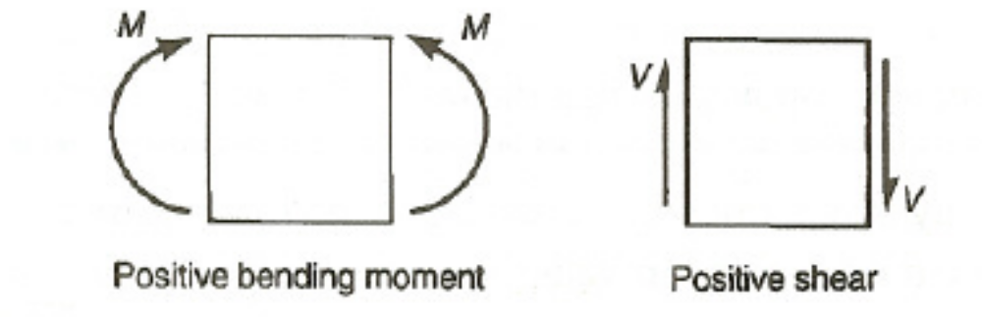
SHEAR AND BENDING IN BEAMS
Shear and moment diagrams are plots of the shear forces and bending moments respectively along the length of a beam.
The most common sign conversion for the shear force and bending moment in beams is shown in Figure 4-1

Slide 4
SHEAR AND BENDING IN BEAMS
One method of determining the shear moment diagrams is by the following steps:
The free body is first drawn and determine the reactions from equilibrium of the entire beam.
The bending moment along the beam is then calculated with emphasis on the extreme and critical points.
Cut the beam at an arbitrary point.
Show the unknown shear and bending moment on the cut using the positive sign convention shown in Figure 4-1.
4

Slide 5
Shearing Force and Bending Moment Diagram
Sum forces in the vertical direction to determine the unknown shear.
Sum moments about the cut to determine the unknown moment.
The calculated forces and moments are used in the drawing of the diagrams.
Figure 4-2 (a) shows a beam supported at the ends A and B.
Figure 4-2 (b) shows the relevant free body diagram with calculated reactions.
5

Slide 6
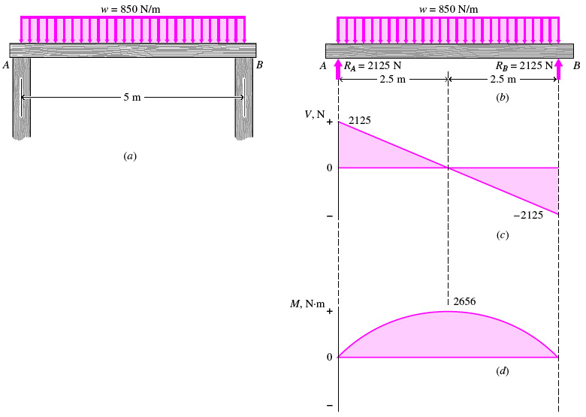
Shearing Force and Bending Moment Diagram
Figure 4-2 (c) and (d) shows respectively the shearing force and bending moment diagrams
6

Slide 7
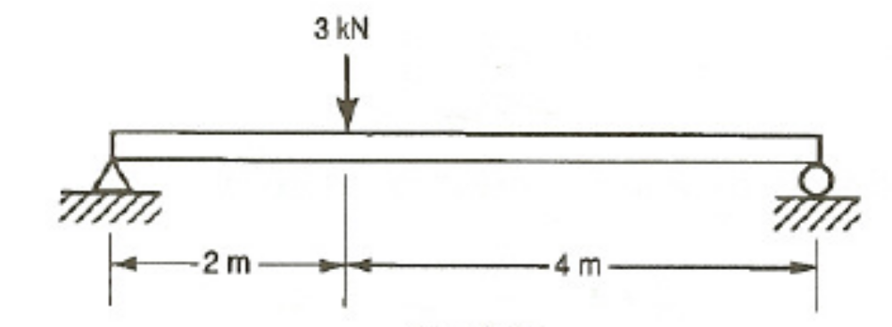
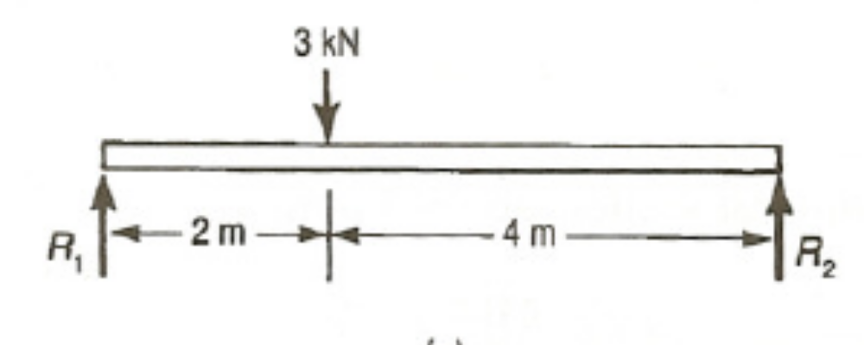
Example 4-1
For the beam shown in Figure E4-1, plot the shear and bending moment diagram.
Solution
First solve for the unknown reactions using the free-body diagram of the beam shown below

Slide 8
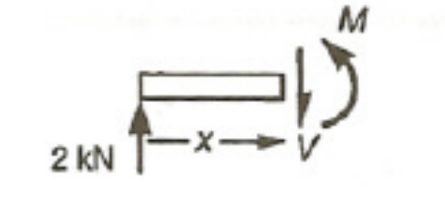
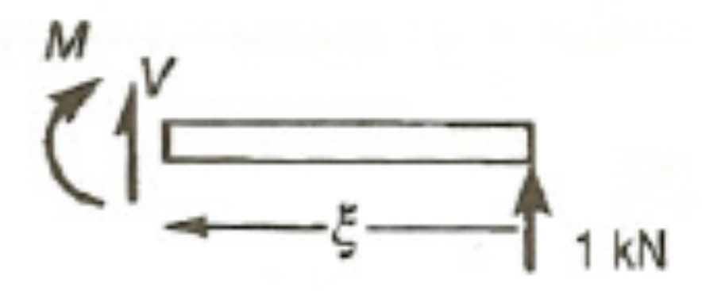
Example 4-1 Continues
To find the reactions:
Cut the beam between the x = 0 and x = 2 m and the load as shown below.
Repeat the procedure by making a cut between x = 2 and the right end of the beam as shown in below
8

Slide 9
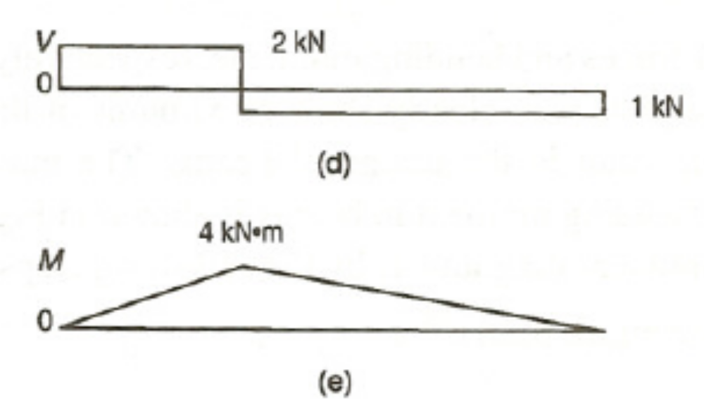
Example 4-1 Continues
9

Slide 10
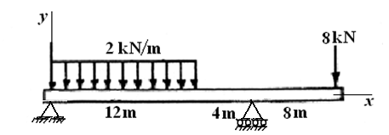
Example 4-2
For the beam in Figure E 4-1, draw:
a free body diagram of the beam
the shearing force diagram of the beam
the bending moment diagram of the beam.
10

Slide 11
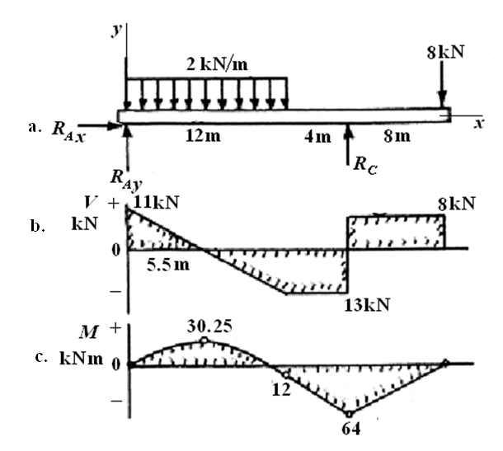
Example 4-2 Continues
11

Slide 12
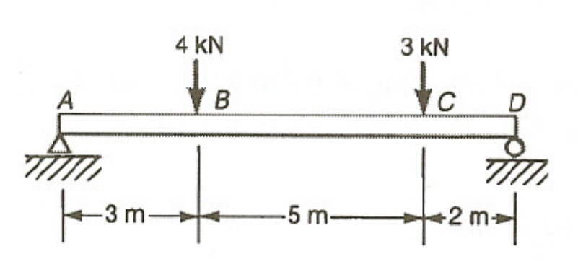

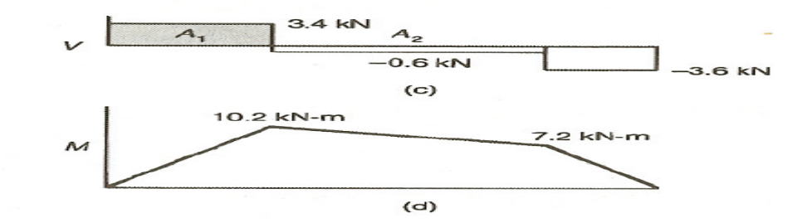
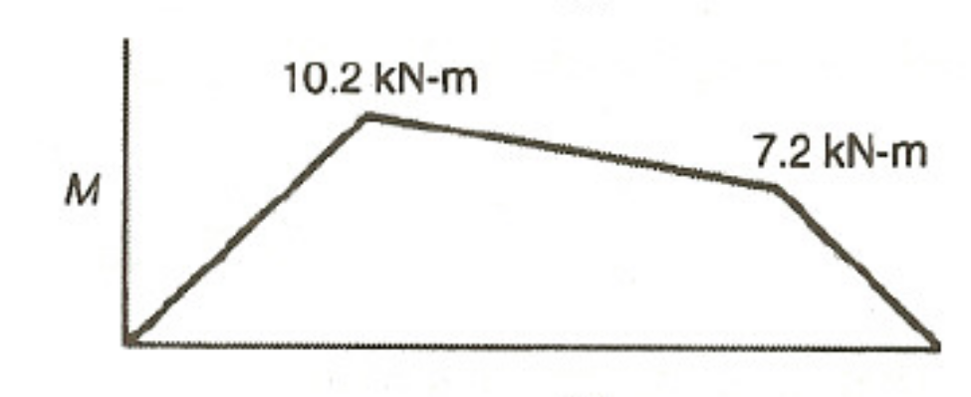
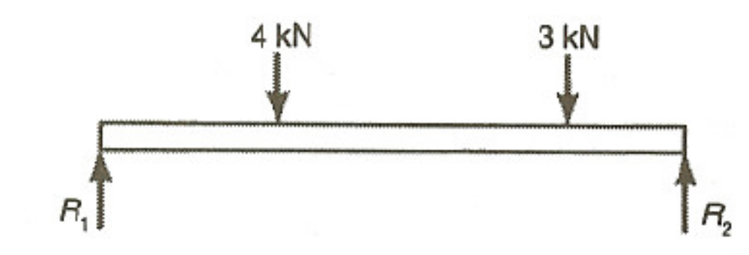
Example 4-3
Draw the shear and moment diagram shown in Figure E5-3.
Solution
Draw the free-body diagram of the beam.
Summation of the moments about the right end
Summation of forces in the vertical direction

Slide 13
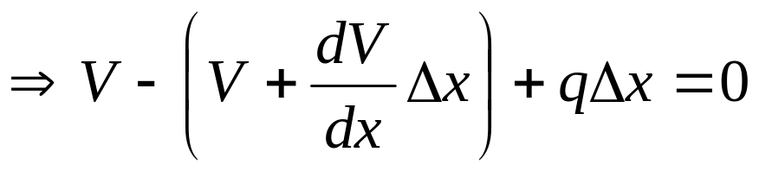
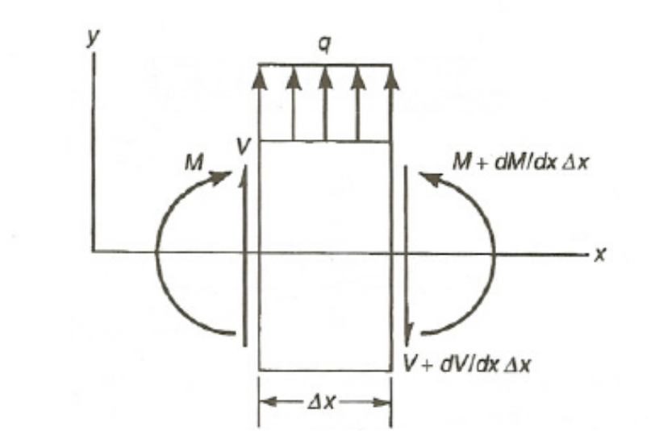
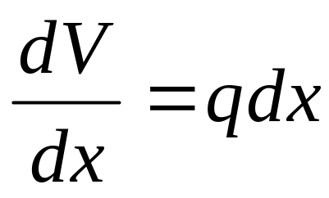
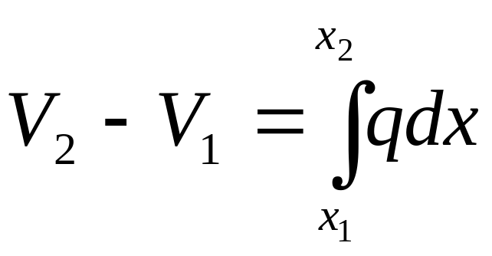
Relation between the Shear force and the Bending Moment
Let us consider a simple supported beam AB carrying a distributed load w per unit length as shown in Figure 4-3.
Summation of forces in the y direction gives
Dividing through by Δx gives
Integrating Eq. (2-34) gives

Slide 14
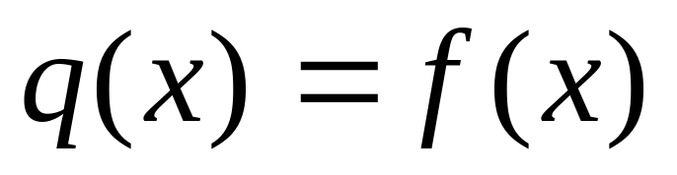
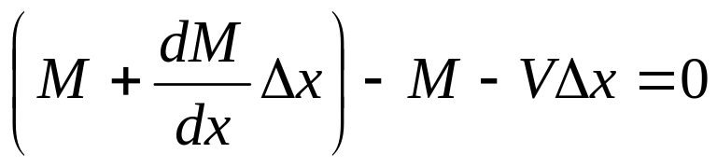
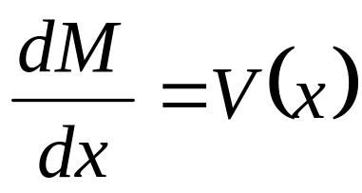
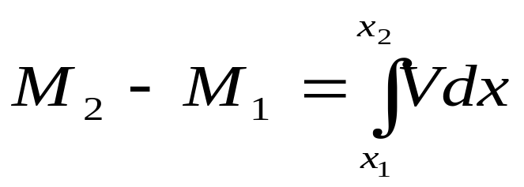
Relation between the Shear force and the Bending Moment
Summation of moments and neglecting higher order terms gives
Dividing through by Δx gives
Integrating gives
Step 1: Express w in terms of the length x;
Thus
Step 2: Obtain V(x) by integrating q(x) within the interval.
Step 3: Find M(x) by determining the area under the shear force diagram or integrating V(x) within the interval.
14

Slide 15
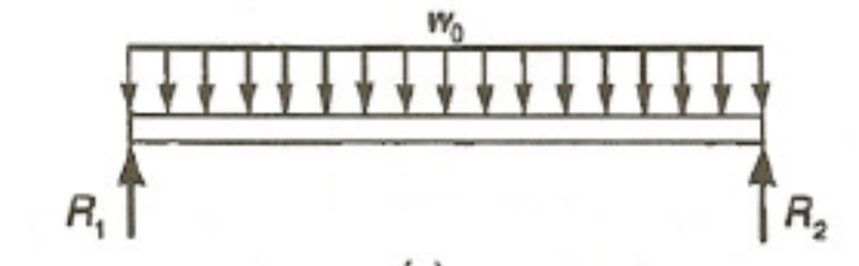
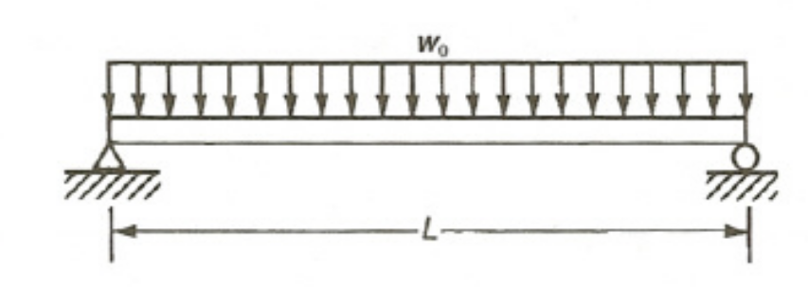
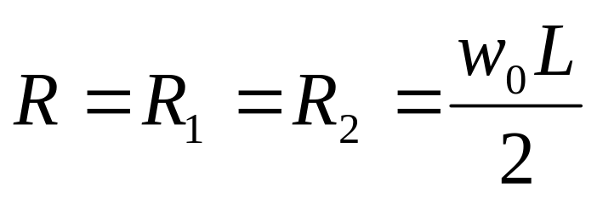
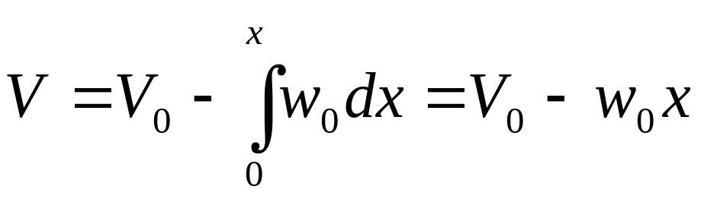
Example 4-4
The simply supported uniform beam shown in Figure E4-4 carries a uniform load of w₀. Plot the shear and moment diagram for this beam.
Summing vertical forces then gives.
The load q = -w₀ integrating gives
Solution
As before, the reactions can be found first from the free-body diagram of the beam.
15

Slide 16
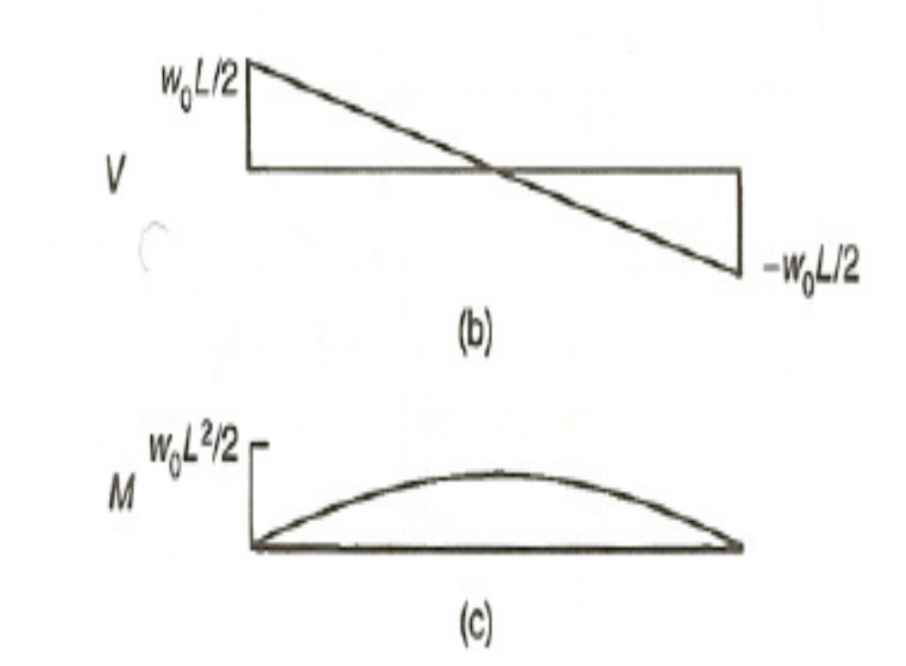
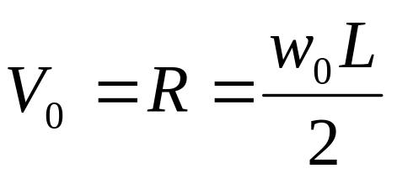
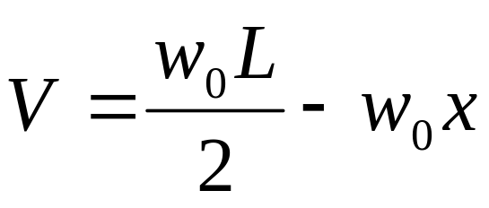
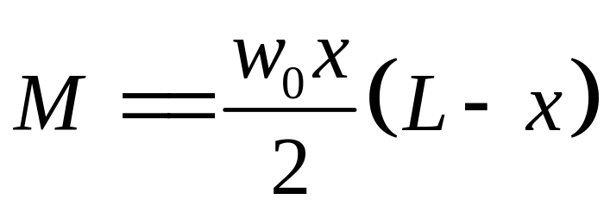
Example 4-4 Continues
But
Therefore
Integrating the above and setting the moment at x =0 to be zero
16

Slide 17
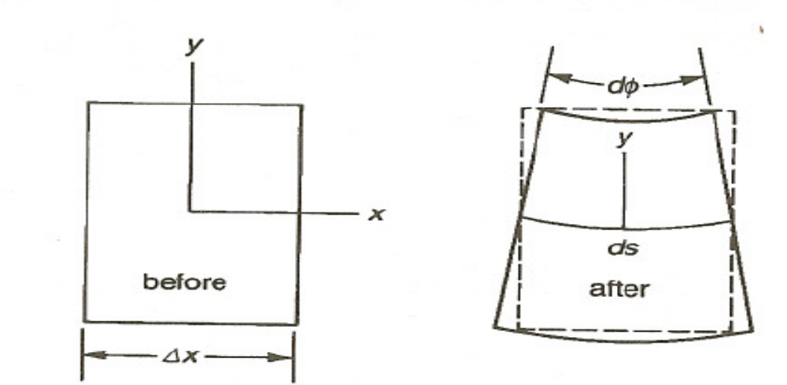
Stresses in Beams
The basic assumptions in elementary beam theory is that the cross-section remains plane and perpendicular to the neutral axis as shown in Figure 5-4 when the beam is loaded.
This assumption is strictly true only for the case of pure bending but gives good results even when shear is taking place.
17

Slide 18
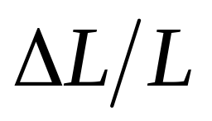
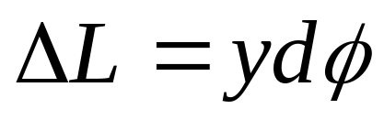
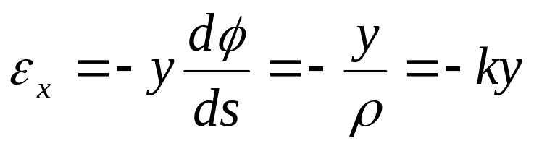
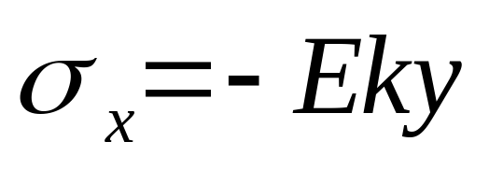
Bending Stress
The distance y is measured from the neutral axis.
The strain in the x-direction is
The change in length
The Strain is
The stress is
18

Slide 19
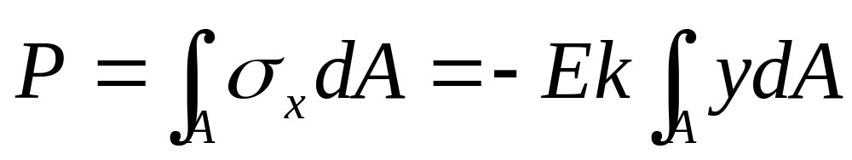
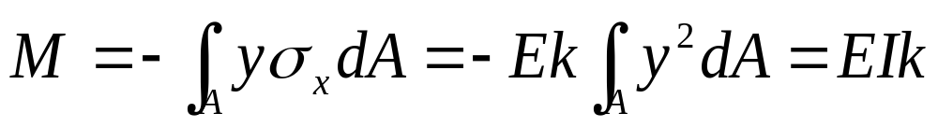
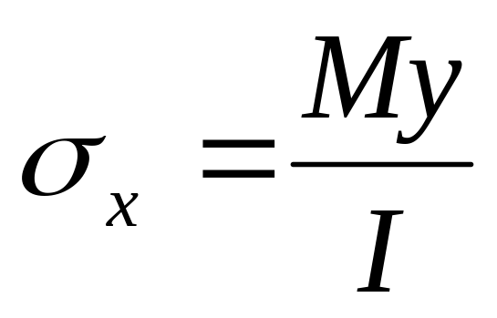
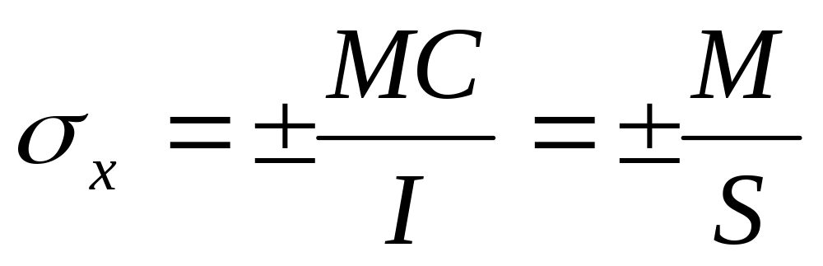
Bending Stress
The axial force and the bending moment can be found by summing the effects of the normal stress σ_{y}:
The bending stress can be expressed as:
19

Slide 20
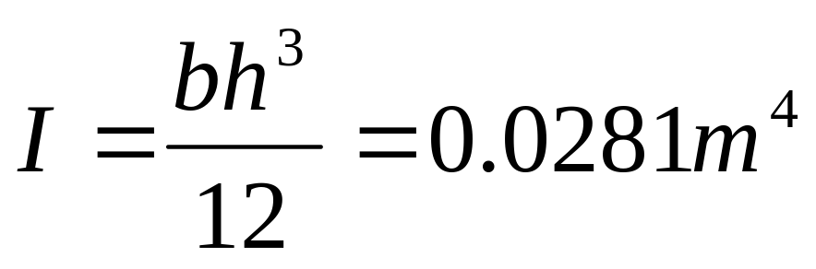
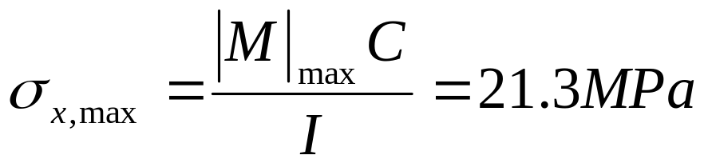
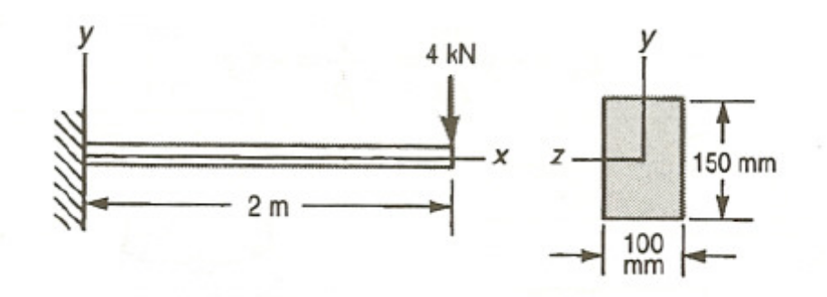
Example 4-5
A 100 mm x 150 mm wooden cantilever beam is 2 m long It is loaded at its tip with a 4 kN load Find the maximum bending stress in the beam shown in Figure EA13 .The maximum bending moment occurs at the wall and is M_{max} = 8 kN- m.
Solution
20

Slide 21
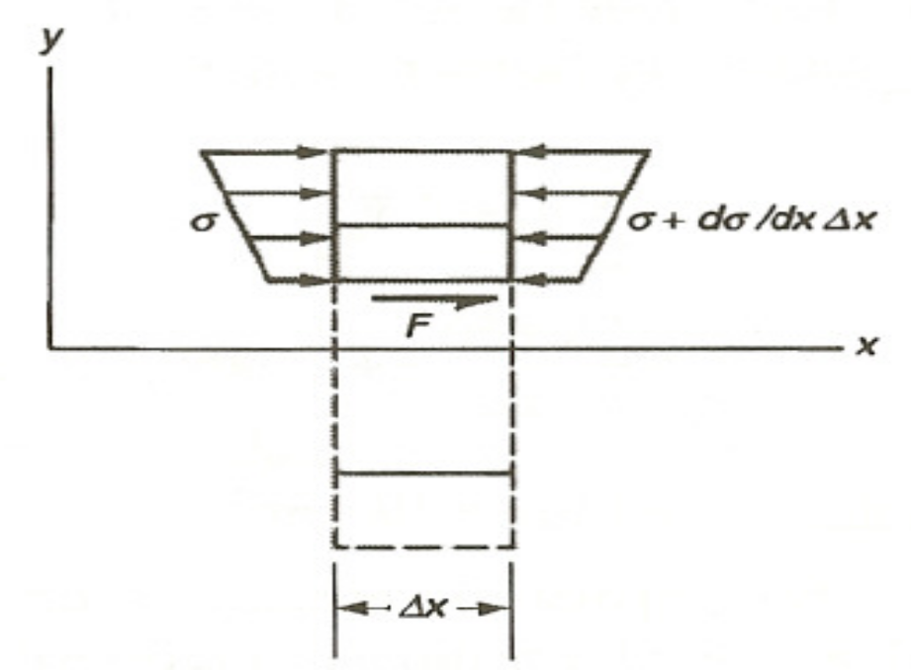
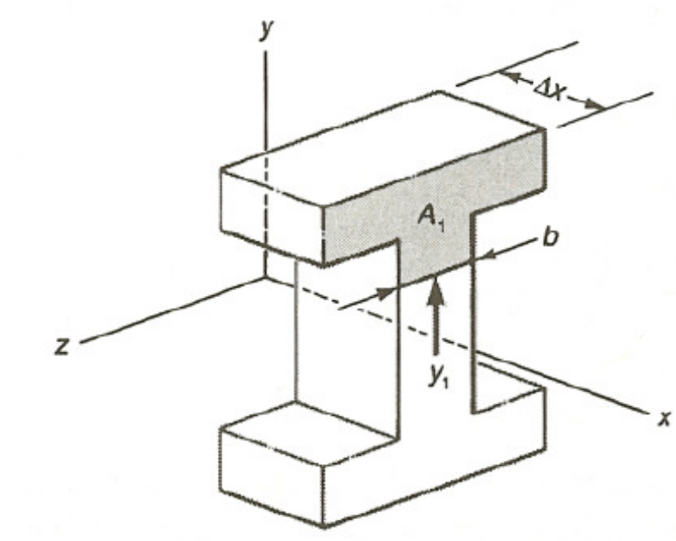
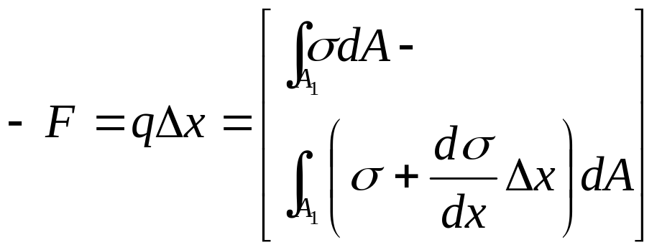
Shear stress
To find the shear stress, consider the element of length shown in Figure 5-5.
The bending stresses acting on that element are shown in Figure 5-6
Summation of forces in x-direction for the free-body diagram shown Figure 5-6
21

Slide 22
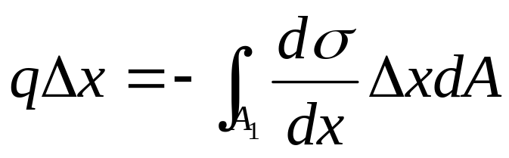
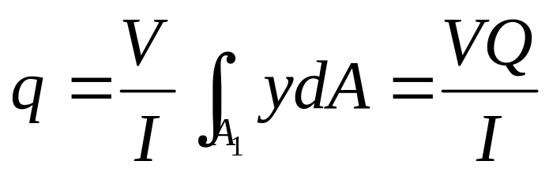
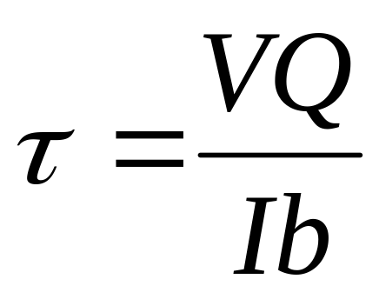
Shear stress
Substituting bending stress equation into the above equation gives
If the shear stress τ is assumed to be uniform over the thickness b, then τ = q/b and the expression for shear stress is
22

Slide 23
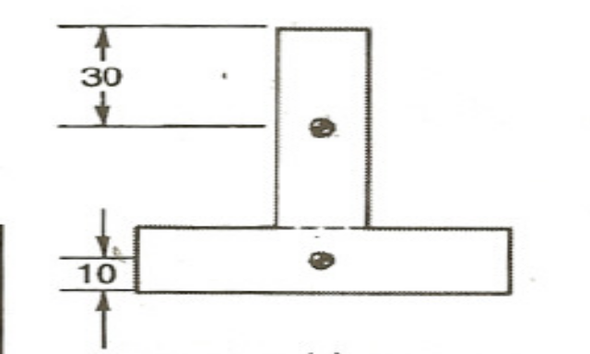
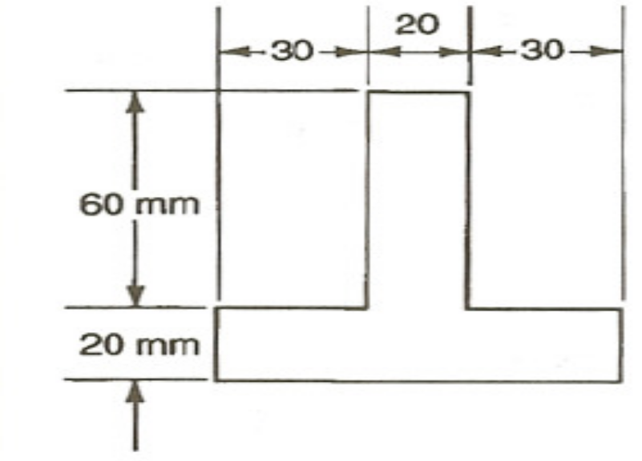
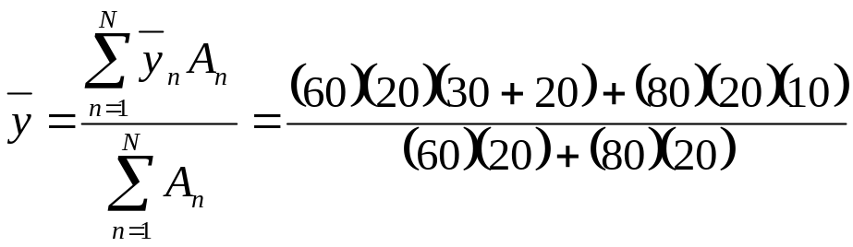

Example 4-6
The cross-section of the beam shown in Figure E4-6 has an applied shear of 10 kN. Find:
the shear stress at a point 20 mm below the top of the beam
the maximum shear stress from the shear force
The centroids of each of the two sections are also shown in Figure below
The centroid of the entire cross-section is found as follows:
23

Slide 24


Example 4-6 Continues
The centroid is shown in Figure (b)
The second moment of area is
24

Slide 25

Example 4-6 Continues
For the point 20 mm below the top of the beam, the area A
The value of Q is then
The Shear stress is
25

Slide 26


Example 4-6 Continues
The maximum Q will be at the centroid of the cross-section.
The maximum moment of area Q_{max} is
The Shear stress is
26

Slide 27

Bend Test
A more convenient way of testing such brittle materials is by the bend test.
A load is applied at three points to cause the bending as shown in Fig. 4-7.

Slide 28

Bend Test

Slide 29

Bend Test

Slide 30

Bend Test
Considering the simply supported beam AB of the length l, and carrying a point load w at the centre of beam c as shown in Figure.
Reactions at the supports,
R_{A} = R_{B} = $\frac{W}{2}$ 1
Considering a section X at a distance x from B. The bending moment at this section is,
M_{x}= RB(x) =$\frac{W}{2}x$ 2
From bending moment equation, $M=EI\frac{d^{2}y}{dx^{2}}$ 3

Slide 31

Bend Test
Substituting Eq. (3) into Eq. (2) and integrating twice, the equation of deflection is EIy = $\frac{{Wx}^{3}}{12}$ + C₁x + C₂ 4
Solving for C₁ and C₂, and substituting these values in equation (4), we get EIy = $\frac{{Wx}^{3}}{12}$ - $\frac{{Wl}^{2}x}{16}$ 5
Maximum deflection occurs at midpoint c, where, x = $\frac{l}{2},$ substituting into equation (5) give a maximum defection of
δ = - $\frac{{wl}^{3}}{48EI}$ 6

Slide 32



Bend Test
The results are recorded a stress-deflection curve (Fig. 4-8).
This is taken to be the maximum direct stress in bending, σ_{x,u}, corresponding to the ultimate moment M_{u}, and is assumed to be related to M_{u} by the elastic relationship

Slide 33


Bend Test
The flexural strength is a measure of the material's strength.
Flexural strength is
Flexural modulus is
where:
F the fracture load
L the distance between the two outer points
w width of the specimen
h height of the specimen
δ the deflection of the beam when a force F is applied.

Slide 34
Example 4-7
A square rod of size 10 mm and 200 mm long was passed through the eye of the load holder and then placed on of the support. A dial gauge is set on top of the load holder on the square rod. A load of 2.5 kg was hanged on the specimen and the corresponding reading of the dial gauge was recorded. The load is increased incrementally of 2.5 kg and the corresponding values recorded until the specimen fails. Determine
The yield strength;
The ultimate strength
The modulus of elasticity
Load (Kg) | 0 | 2.5 | 5 | 7.5 | 10 | 12.5 | 15 | 17.5 | 20
Deflection (mm) | 0 | 0.01042 | 0.02083 | 0.03125 | 0.04167 | 0.05208 | 0.0625 | 0.1875 | 0.505

Slide 35
Example 4-7 Continues

Slide 36



Example 4-7 Continues
Length = 200 mm; y = 5 mm; I = 833.33 mm⁴
Stress but
This implies
Where m is the load in Kg
The yield strength
From the plot, yield load is 12.5 Kg, therefore, the yield stress is 12.5(3) = 37.5 Nmm⁻²

Slide 37



Example 4-7 Continues
The ultimate strength
From the plot, yield load is 20 Kg, therefore, the yield stress is 20(3) = 60 Nmm⁻²
The modulus of elasticity
From the plot, the slope is 240
From eq. 6,
This implies
Hence

Slide 38
THANK YOU

